Slide 1
BM7703
Assessment Support session 6
Sara Hooke

Slide 2
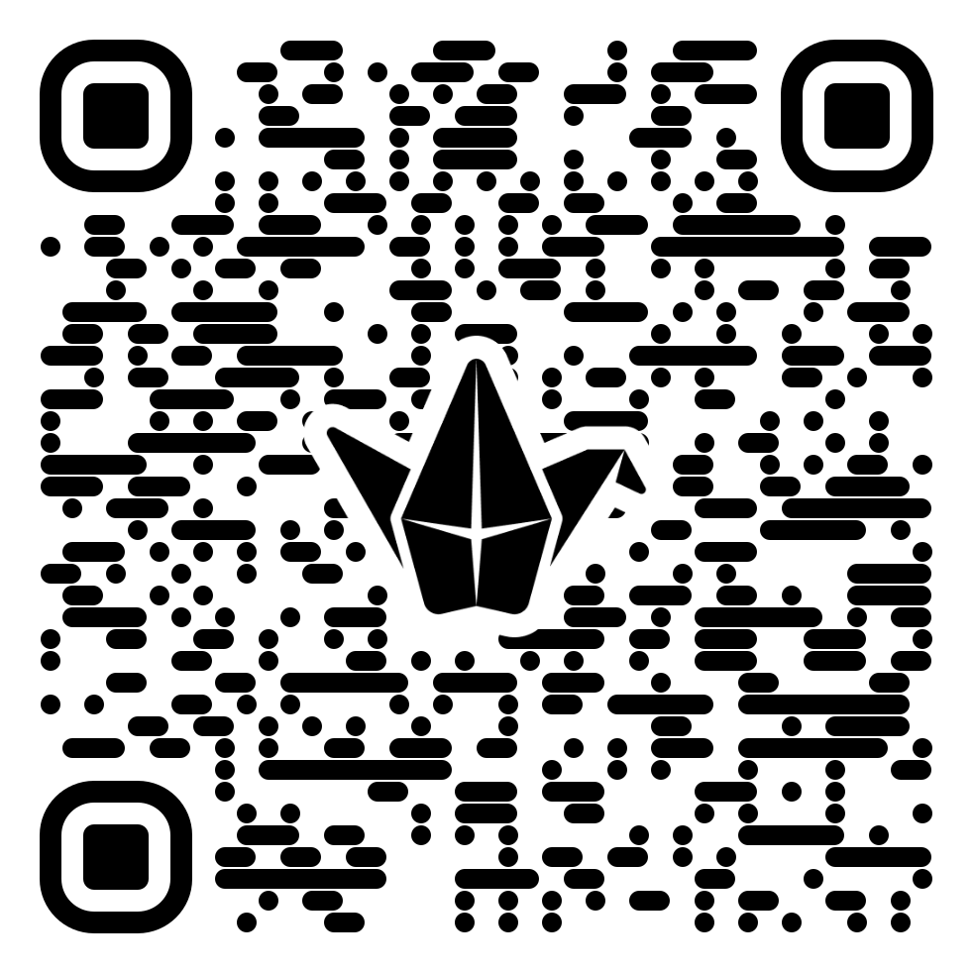
Assessment Padlet
Please submit questions about the assessment on the Assessment Padlet.
It can be found at the top of the main Moodle site for this module.
From the questions submitted I will create a FAQs.
I will also talk about queries in our assessment session next week.
https://padlet.com/uniofglos/bm7703-assessment-questions-8q3nbeoncm5nbtji

Slide 3
COuntry cultures of team members
Nigeria
Netherlands
China
Don’t forget there is UK manager
There will be negotiation with a Vietnamese company

Slide 4
Assessment Brief
https://moodle.glos.ac.uk/mod/assign/view.php?id=2327136 (E)
https://moodle.glos.ac.uk/mod/assign/view.php?id=2327266 (F)

Slide 5
A note on Referencing
Link to quick APA referencing guide which is on the moodle site
https://connectglosac.sharepoint.com/sites/library-resources/Guides/APA%20Referencing.pdf
Also use the library website
https://sites.glos.ac.uk/library/referencing-and-study-skills/referencing/
Use the Cite them right website
https://www-citethemrightonline-com.glos.idm.oclc.org/

Slide 6
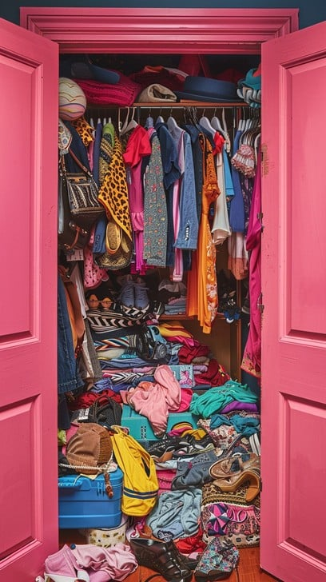
Avoid this!!!

Slide 7
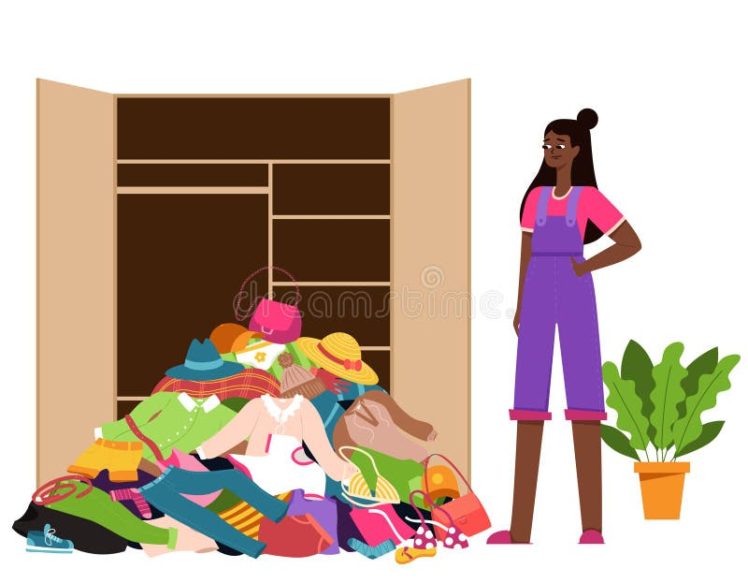

Slide 8
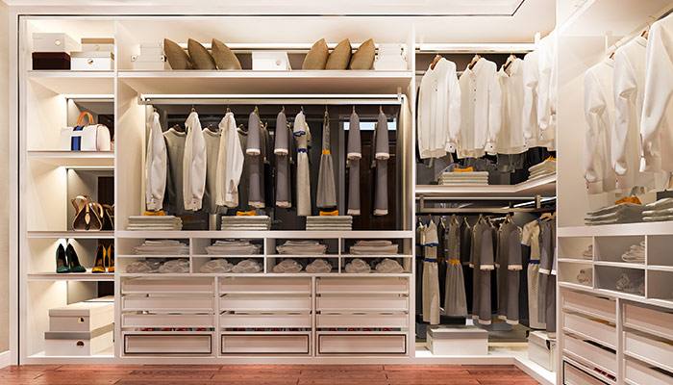
Use frameworks/ dimensions to organise your work.

Slide 9
Suggested report layout
In Session 6 Assessment Clinic tile in Moodle

Slide 10
Theories/Dimensions
Hofstede
Erin Meyer
GLOBE
Schwartz
Trompenaars

Slide 11
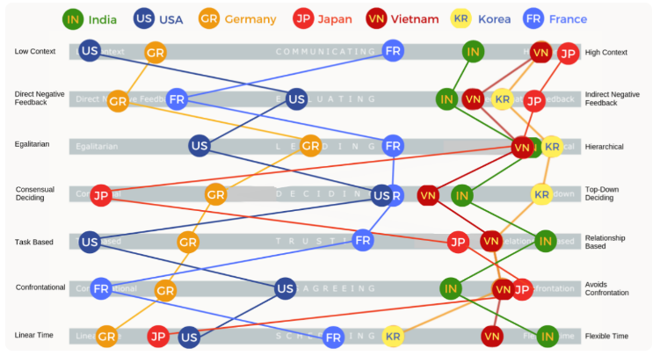
Resources for cultural dimensions
https://www.theculturefactor.com/country-comparison-tool
Google ‘Erin Meyer culture map’ + the culture you are researching and look at the images. You will find…

Slide 12
1. What issues might individual group members experience whilst working on this project? Consider communication and trust.
Review sessions 1-5 and you will have enough knowledge to answer this question.

Slide 13
2. How best to lead the team? What issues might the team experience? How should decisions be made and what style of leadership should they use?
By the end of Session 7 (tomorrow) on Multicultural Teams you will have covered enough theory in previous weeks to answer this part of the assessment

Slide 14
3.Who would be best to lead the negotiations with the Vietnamese company?
Session 8- Negotiation + other weeks too.

Slide 15
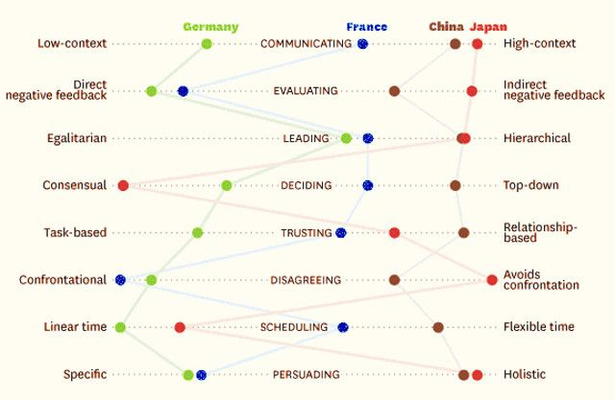
ERIN MEYER CULTURAL MAP PLOT
Hall
Meyer
Hofstede
House
(GLOBE)
Meyer
Chua &
Morris
Meyer
Hall
Nisbett

Slide 16
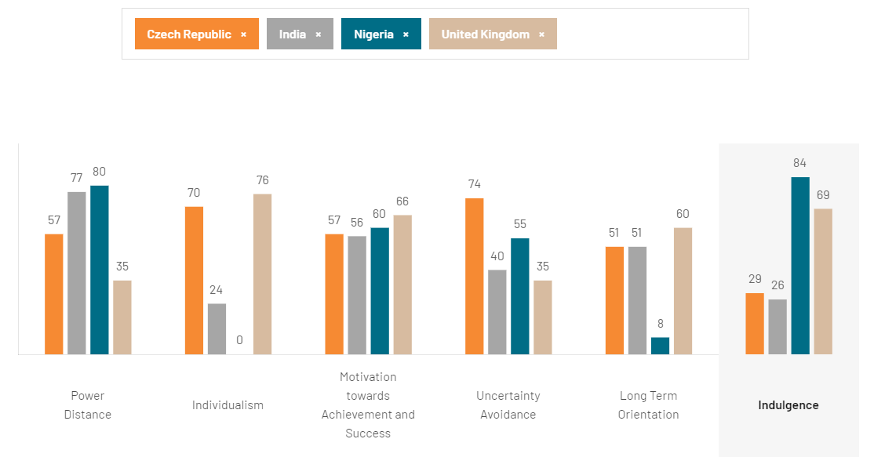

Slide 17
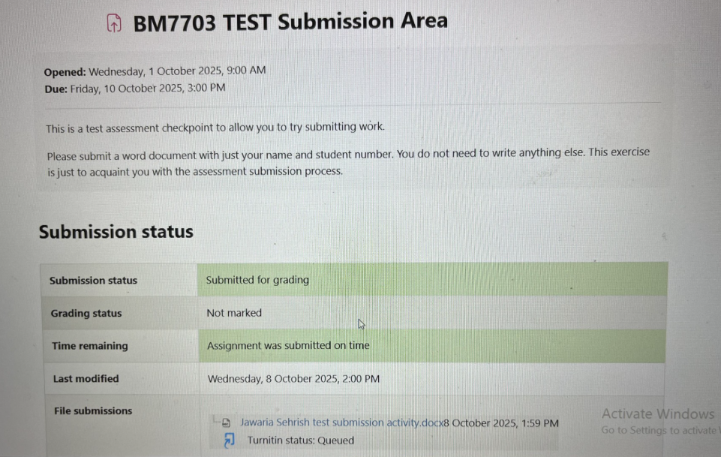


Make sure you fully submit!

Slide 18
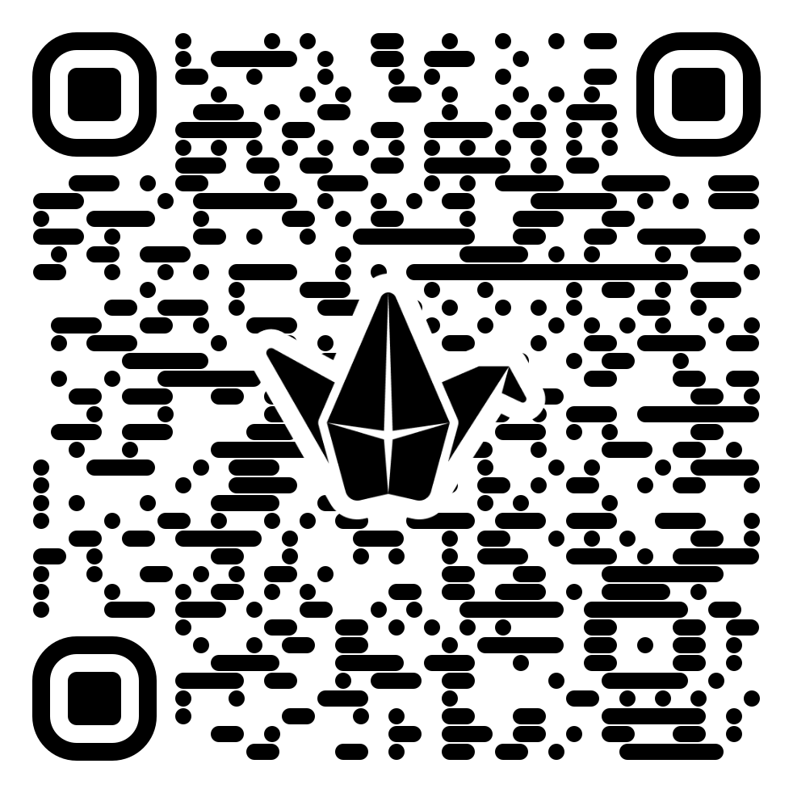
task
Pin
Looking at the examples provided, what grade would you award…
https://padlet.com/uniofglos/what-grades-would-you-award-wam4uf66ywnxty2b

